Slide 1
Term Project
Jack Huffman

Slide 2
Intro
Problem
Today the state of education is constantly trying to find a way to improve a students’ scores. This project aims to expand on how they can do that. By leveraging advanced Data Science techniques as well as extracting meaningful insights from otherwise general data will show how key the student, or rather, how their lives expand the scope of what we consider to be truth in predicting how a student will do on any given exam. Using statistical methods learned throughout the year, we will explore how external factors such as study hours, attendance, Learning Disabilities, previous scores, and tutoring session can influence an Exam.
Question:
How do external factors influence students' math, reading, and writing scores? What features can we generate to increase the prediction of how a student will score based on other features?
Null Hypothesis:
There is no difference in scores based on selected external factors
Alternative Hypothesis:
There is a difference in scores based on selected external factors

Slide 3
Dataset
Dataset:
StudentPerformanceFactors
High level:
The dataset used for this analysis has a multitude of factors that can be considered essential to predicting a students score. From Academic factors like how often the student studies to more personal factors like parental demographics and other external factors that affect the student are examined when determining what we can account for in terms of scores.
Columns of interest:
Hours_studied, Attendance, Parental Involvement, Previous_Scores, Tutoring Sessions
Rationale:
Each feature not only expands on what we know to be common sense but add a quantified measure of how each can impact a score via the distributions by student.

Slide 4
Variables
Feature | F-Score | MI Score | Desc
Attendance | 131.977 | 0.301 | Percentage of classes attended by a student. Meaured in percentage from 0 - 100
Hours Studied | 58.124 | 0.155 | Total study hours per week. Measured in hours from 0 to 45
Previous Scores | 7.651 | 0.015 | Students past academic performance. Measured in percent score from 0 - 100
Tutoring Sessions | 6.002 | 0.015 | Number of extra help sessions attended. Measured in sessions from 0-8
Learning Disabilities | 3.261 | 0.017 | Indicates if a student has a diagnosed learning disability. Measured in Yes or No
There are many variables in this dataset, 20 to be exact. However, using basic statistics like F-Score and MI score we can grab which features may be the most important for predictions like in the table shown
Information like this can help us get a good idea of what to look for in features. As such this is why we picked these features to be included in statistical analysis and model evaluation.
Though the MI scores are low, the F-Score being high shows that each variable can having variation can provide positive signal to a model when it is predicting.
This not only statistically shows why we should use these features, but it also reinforces what we know to impact scores based on common sense.

Slide 5
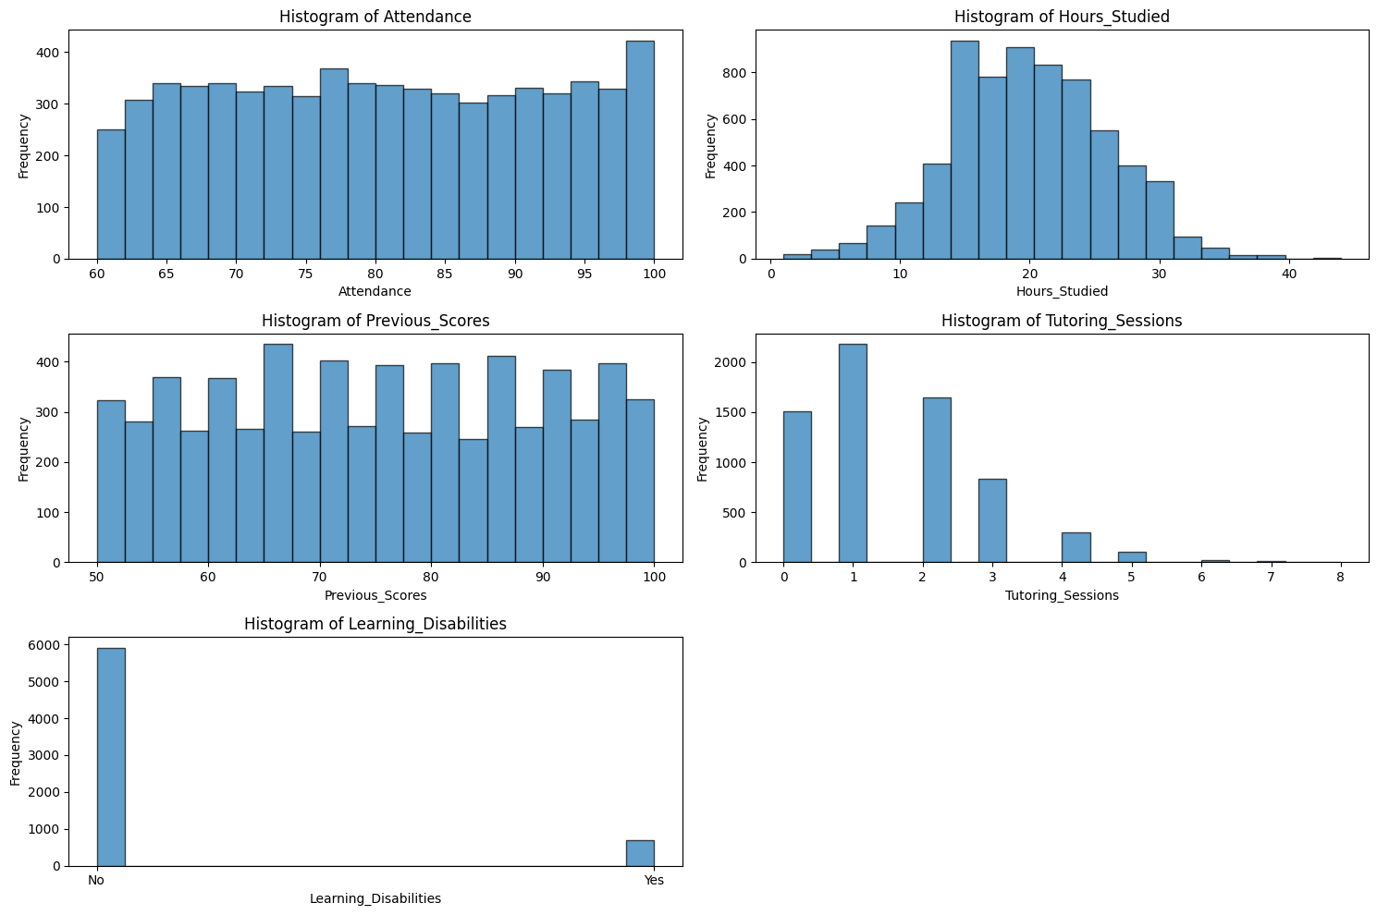
Graphs
The variables are important to understanding how we can predict scores. Viewing the distributions and outliers help understanding the data:
Attendance:
Roughly Uniform
Outliers are not extremely present if at all.
Hours_studied:
Slight right skew
Outliers at >40 or <5 hours
Previous Scores:
Roughly Uniform
No real outliers
Tutoring Sessions:
Right Skew
Outliers at +6 sessions
Learning Disabilities
Right skew
Outliers are children with disabilities

Slide 6
Graphs - Extended
Of course, the variables are different and need to be treated fairly in anticipation of that there are suggestions on how to handle the outliers in the data. This information lets us refine our data evaluation and gives a more powerful analysis to answer our hypothesis.
Feature | Distribution | Outliers | Handling
Attendance | Uniform | <95% attendance | Analyze <95% separately; remove extremes
Hours Studied | Right-skewed | <5 or >40 hours | Cap >40 hours if it lowers scores
Previous Scores | Mostly uniform | Scores near 50% | Flag <55% for intervention; use performance bands if necessary
Tutoring Sessions | Right-skewed | >6 sessions | Check if >6 sessions improves scores or signals struggle
Learning Disabilities | Imbalanced | Small group with disabilities | Retain; analyze separately for tailored support

Slide 7
Variables: Mean, Mode, Std
The Variables we have need to be analyzed on a statistical level like so:
Mean: We see the central tendency of our variables that highlights what we can expect from most students
Mode: We can see the most often occurrence amongst the students and will highlight what we can expect to see the most
Std: This shows us how much variation in the variable we can expect and can point to a potential uplift in model performance later
Skewness: This shows us how skewed each variable is and lets use get an idea of the shape of the data
Kurtosis: This shows us how pronounced the tail of the data is and can highlight some outliers that we can point out.
Feature | Mean | Mode | STD | Skewness | Kurtosis
Attendance | 79.97 | 67 | 11.55 | 0.01 | -1.19
Hours Studied | 19.98 | 20 | 5.99 | 0.01 | 0.02
Previous Scores | 75.07 | 66 | 14.40 | -0.00 | -1.19
Tutoring Sessions | 1.49 | 1 | 1.23 | 0.82 | 0.64
Learning Disabilities | 1.22 | 2 | 0.87 | -0.44 | -1.52

Slide 8
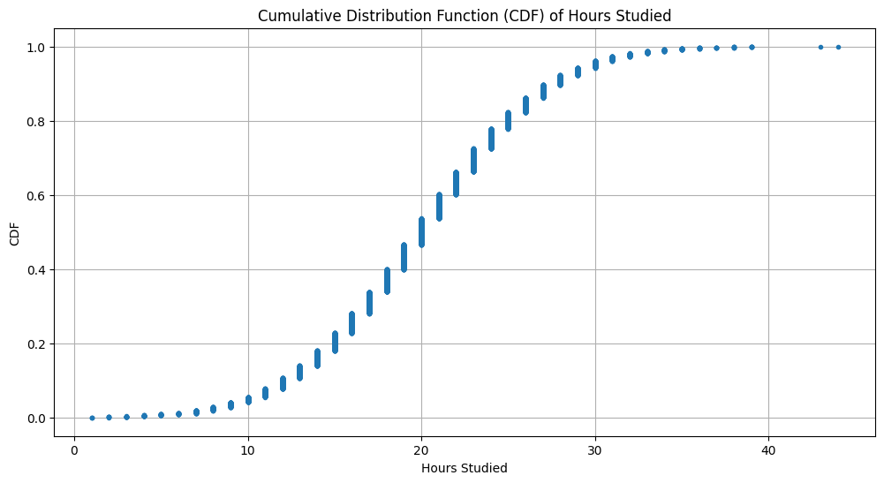
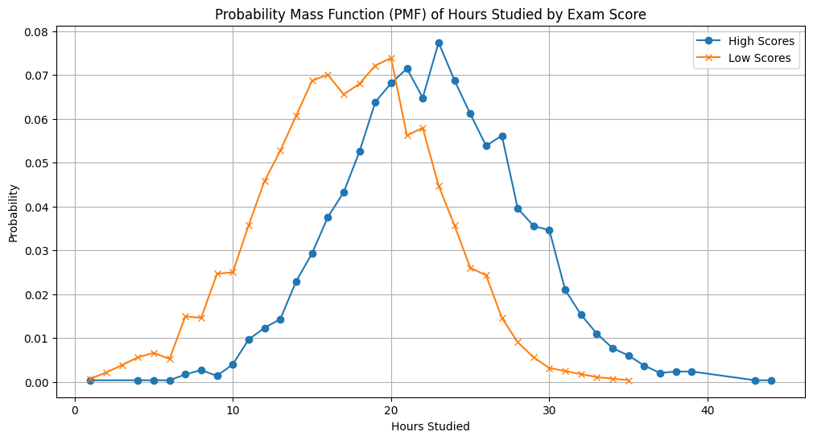
PMF/CDF
PMF:
In this scenario we compared two variables and two scenarios. We looked at students that score high on exams and students that score low and compared their results. As a students' we notice that the higher performing students' study on average 10 hours more than the lower scoring students as demonstrated by the graph. We now know that with these results, we can expect to see higher scores from students with more hours studied and the converse from students with low study hours.
CDF:
As a broad examination of all students the CDF confirmed some key observations that lead us to believe study hours can have a positive/negative impact on scores. The graph shows that 75% of students spend 10 to 30 hours studying. This suggests to use that most students fall within that range and any deviation of that could be beneficial to understanding how the extreme values can impact an Exam.

Slide 9
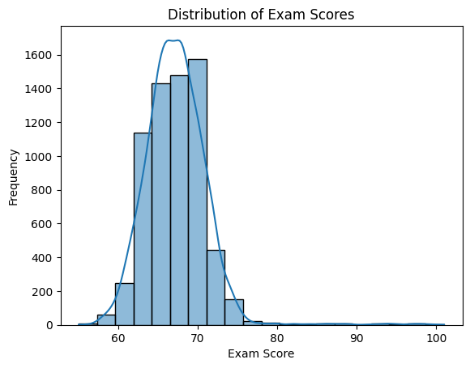
Distirbution
In order to understand the scores at an even higher level than PMF and CDF we can look at the distribution of scores amongst students to fully realize what we have for a sample of the student body.
We notice a right skewed graph with most scores falling in the 65-70 range which given prior knowledge somewhat average.
This highlights the small group of students that do exceptional on exams but also demonstrates that it is a lower population as compared to lower performing students.
We also know that with a Shapiro-Wilk test we observe a p-value of 0.000 so, meaning we can reject that this falls under normality.

Slide 10
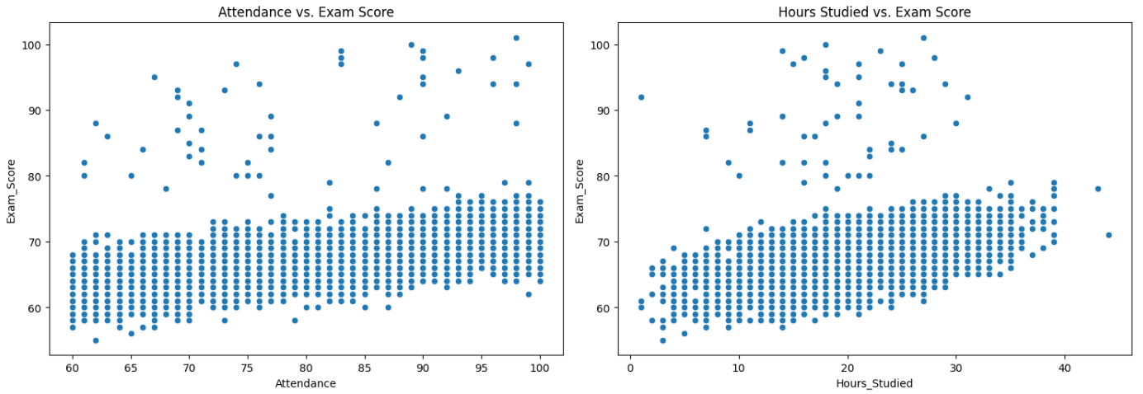
Scatterplots
The scatter plots created looks at the two most interesting variables when comparing to exam scores.
Attendance: We notice a weak positive trend which can mean that higher attendance can elevate exam scores which validates prior statistical tests.
Hours Studied: Like Attendance we also notice a weak positive trend albeit a little stronger than attendance. This can mean that students who study in moderation experience higher scores but if the over/under study their scores may suffer as a result
While these plots indicate a positive trend, analyzing the correlations numerically will show that for both variables, there are positive trends which can positively impact a model and how we understand what affects an Exam score.

Slide 11
Correlations
In conjunction with the scatter plots, correlations enforce the observations made in the previous slide:
Like in the previous slide we notice that there are weak to moderate positive correlation with Exam_score which re-affirms previous observations. Although we would like these scores to be higher to definitively say they help predict scores, it is a good start.
 | Attendance | Hours_studied | Exam_score
Attendance | 1.000 | -0.009 | 0.581
Hours_studied | -0.009 | 1.000 | 0.445
Exam_Score | 0.581 | 0.445 | 1.000

Slide 12
Hypothesis testing / Stats
Feature | Observed Difference | P-Value | Significant
Attendance | +3.88 | < 0.05 | Yes, the P-val is less than 0.05
Hours Studied | +2.77 | < 0.05 | Yes, the P-val is less than 0.05
Previous Scores | +1.21 | < 0.05 | Yes, the P-val is less than 0.05
Tutoring | +1.03 | < 0.05 | Yes, the P-val is less than 0.05
Learning Disabilities | -1.08 | < 0.05 | Yes, the P-val is less than 0.05
Using ANOVA we see that for the variables we selected, the P-Values are less that 0.05 which means we can reject the null hypothesis. This indicates that the features we have can significantly influence exam scores.

Slide 13
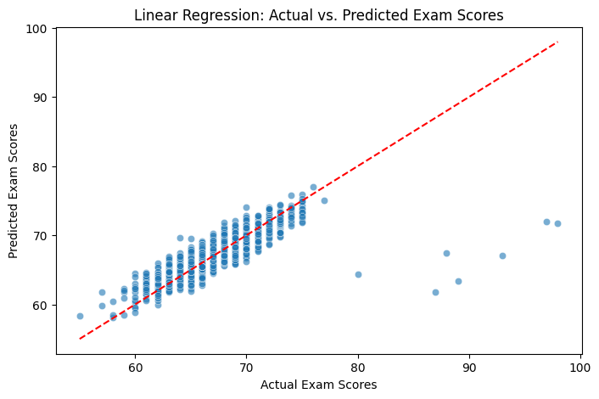
Regression Analysis
Linear Regression is one of the final steps of this process where we take all of the variables, we have deemed important and need to input into a Linear Regression model. To enhance the model some slight feature engineering occurred and ran the model and observed the following
We can see that the model responds exceptionally well to the metrics fed into it and using the observations of the statistics we notice a great increase in accuracy and good bias
MAE | R^2 | Accuracy | Bias
1.28 | 0.64 | 98.15% | 0.013

Slide 14
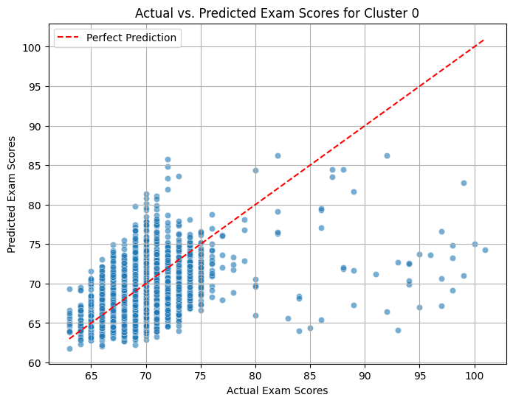
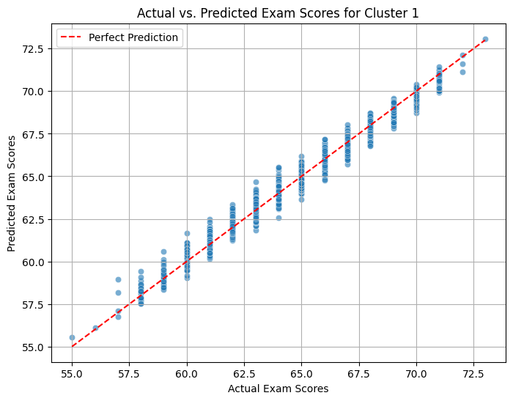
Extended piece
As a side project within this I decided to take it a step further and utilize some work experience and implement a LGBM style algorithm to practice. Results are in the notebook, but the results are similar to that of linear regression model.
Steps done:
Segmentation of data into 2 clusters
Hyperparamter tuning of models based on 2 clusters
LGBM Execution
Cluster | Accuracy | Bias
0 | 98.28 | 0.039
1 | 99.35 | -0.006

Slide 15
Conclusion
We were able to prove both via statistics and model performances that have impacts on how a student performs. More broadly we were able to prove that with a features that students can control they can tune their experience and make adjustments to improve their academic performance with informed data.
Some challenges faced were analyzing some categorical values and figuring out how we might handle the outliers for those variables. Gor example Learning_disabilities is a Yes, No variable and needed to be encoded before working with it at scale. Also, handling outliers for this wasn’t explicitly easy.
Some future work to be done is making a program that will analyze more features with more students and then also, creating a recommender program that will recommend how the student can improve their score in the most optimal way. Almost like Hyperparamter tuning their habits that they can explicitly control.

